Slide 1
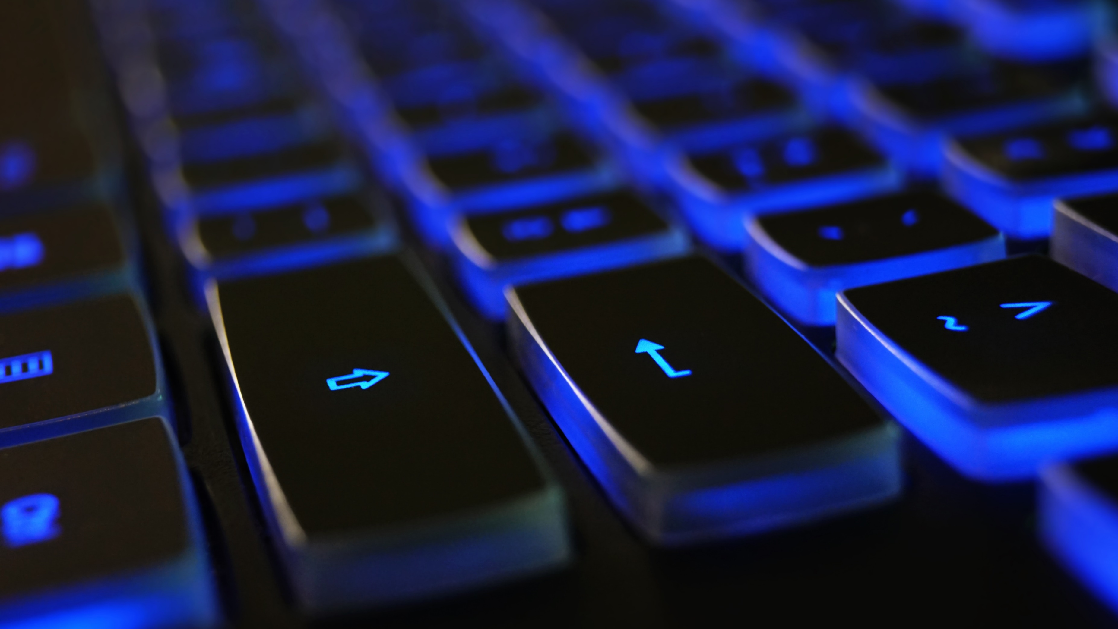
Introduction to Computer Science Introduction à l'informatique مقدمة في علوم الكمبيوتر

Slide 2
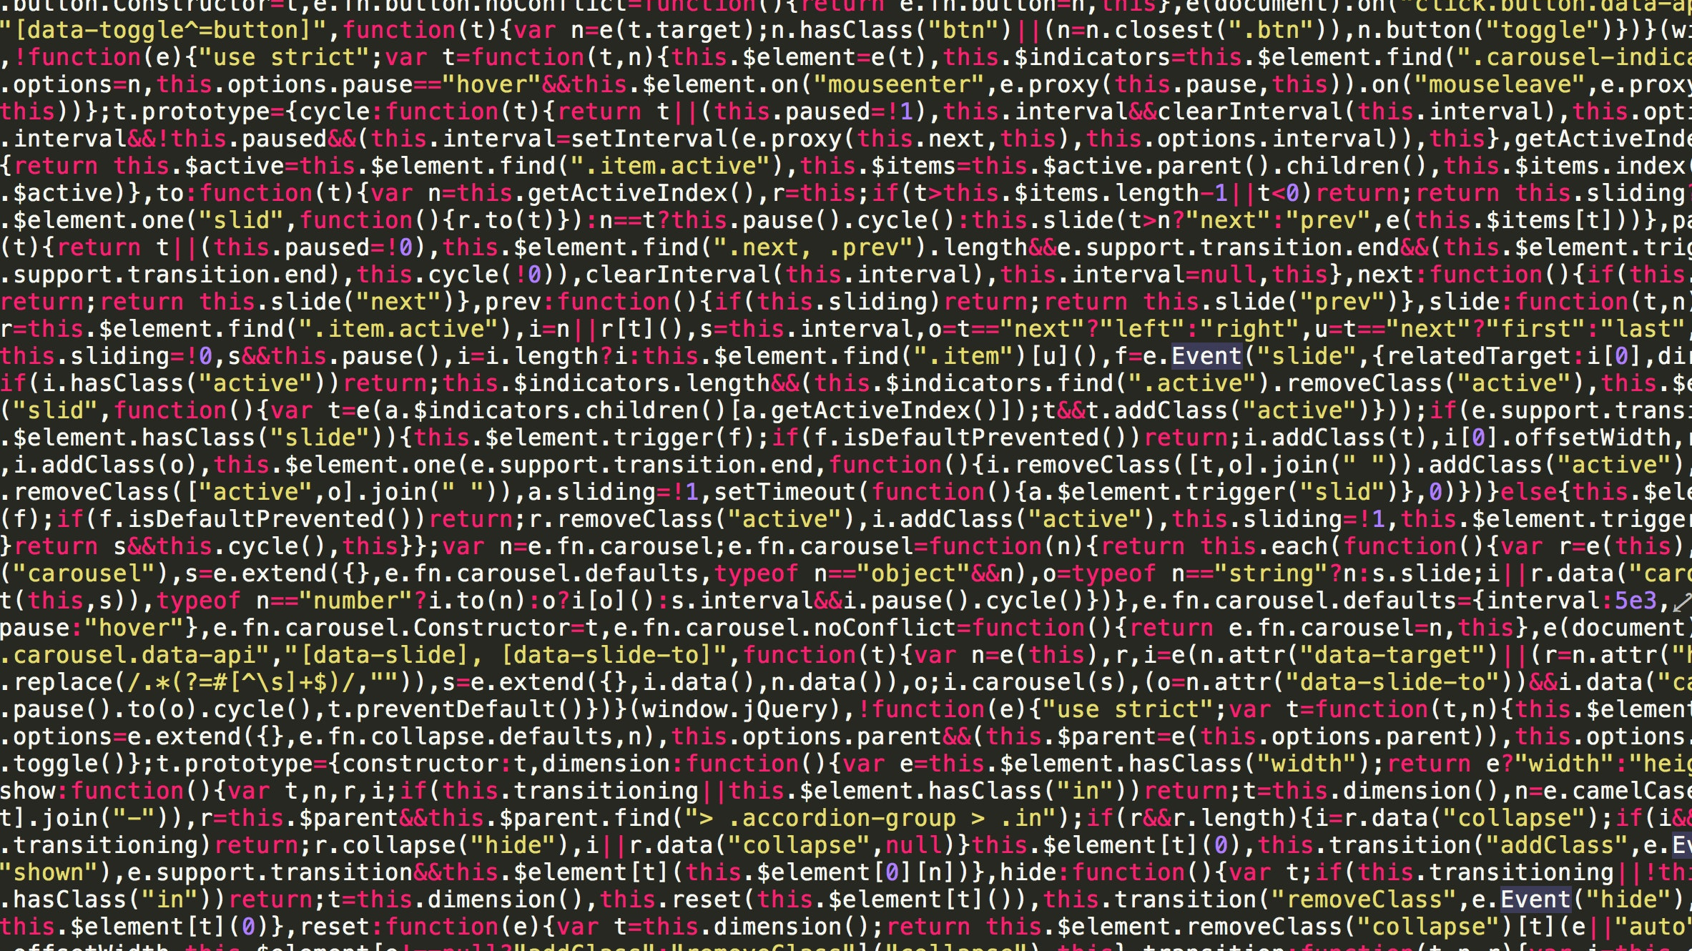
What do you understand by programming? Qu'est-ce que la programmation ? ما هي البرمجة؟

Slide 3
Definition of programming
Programming is the process of writing programs. Programs are a set of instructions given to a computer in order to make it do a specific task.
La programmation est le processus d'écriture de programmes. Les programmes sont un ensemble d'instructions données à un ordinateur afin de lui faire effectuer une tâche spécifique.
البرمجة هي عملية كتابة البرامج. البرامج عبارة عن مجموعة من التعليمات المعطاة لجهاز الكمبيوتر لجعله يقوم بمهمة محددة.

Slide 4
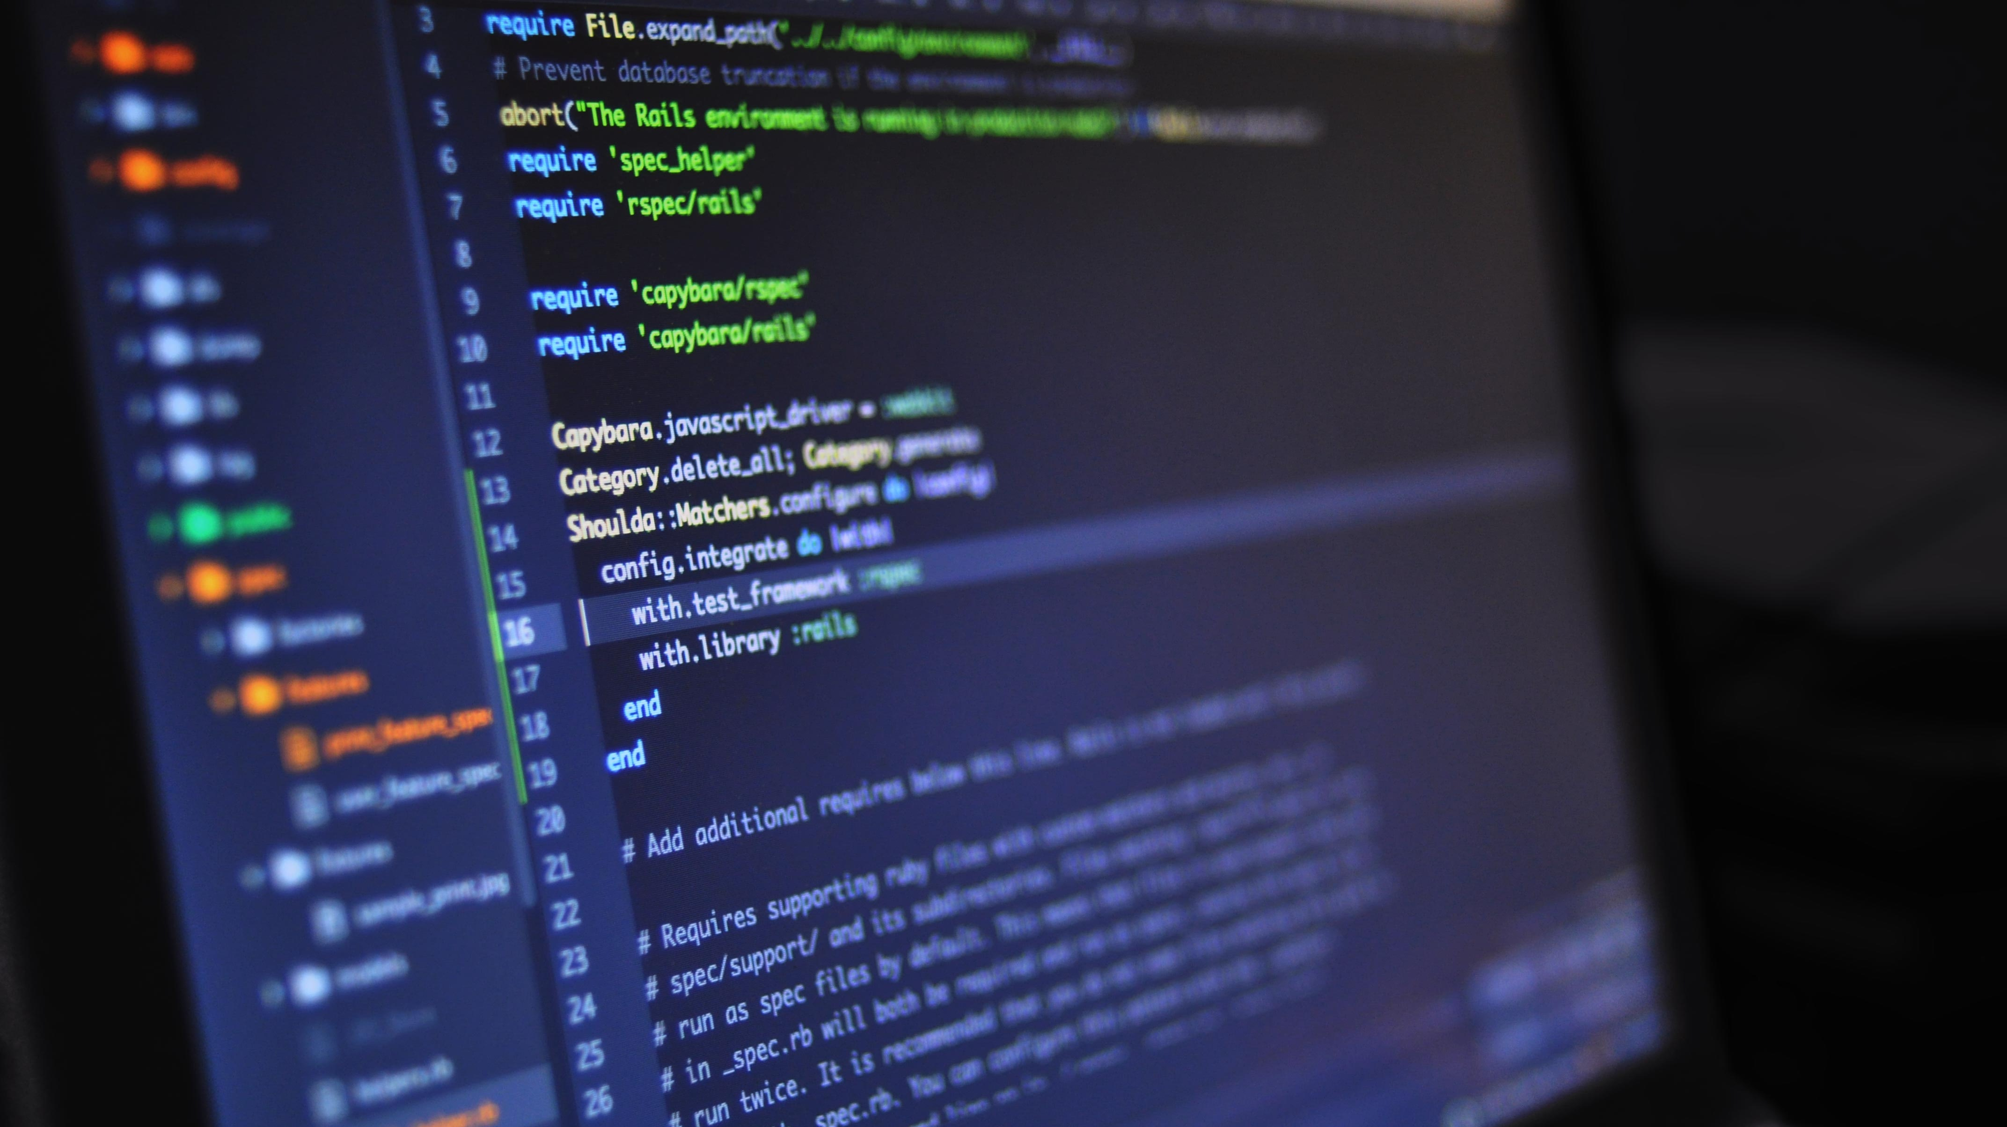
Examples of programs? Des exemples de programmes ? أمثلة على البرامج؟

Slide 5
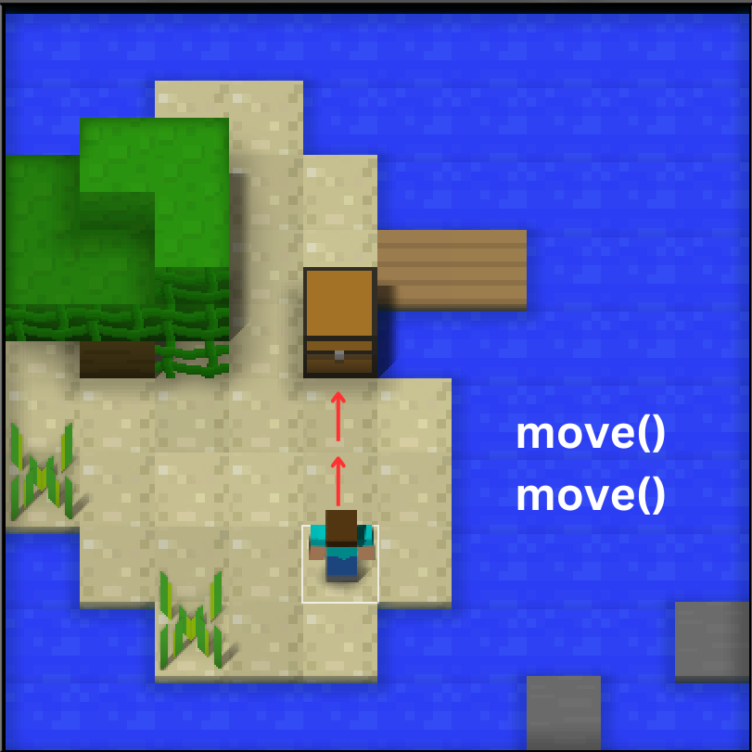

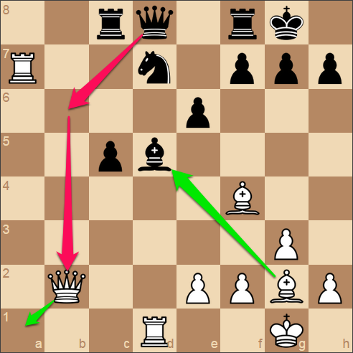
Example of Programs

Slide 6
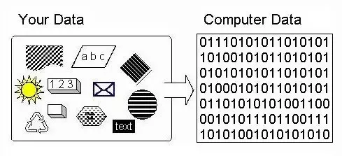
How computers store data?

Slide 7
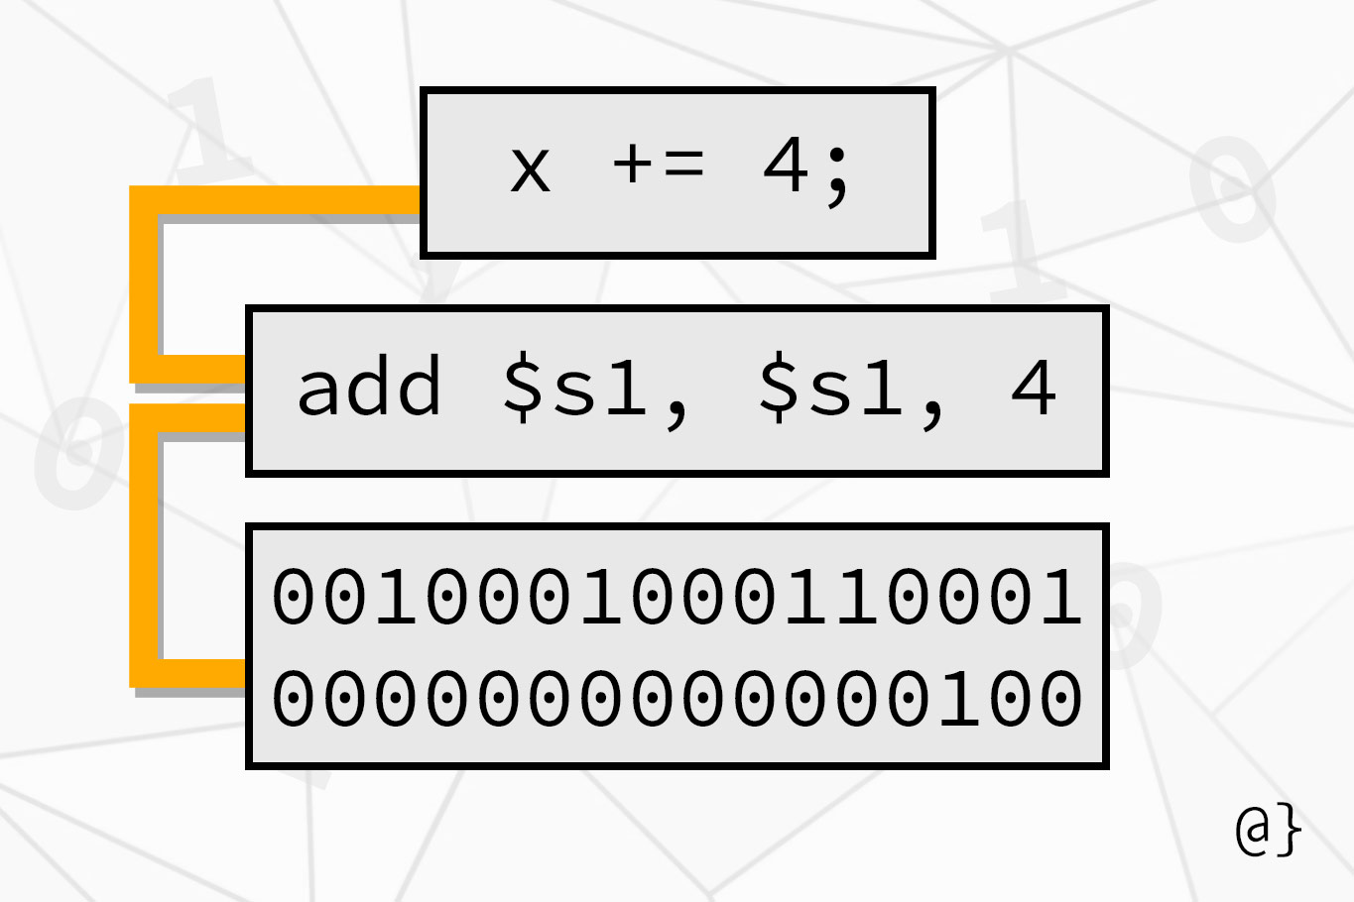
How computers understand programs?
Humans write in an easy-to-understand programming languages which computers don’t understand. So, programs are translated into 0s and 1s called machine code.

Slide 8

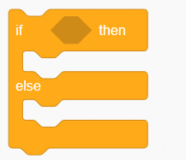

Example of commands
raining

Slide 9
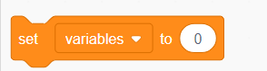
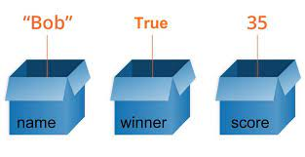
Variables

Slide 10
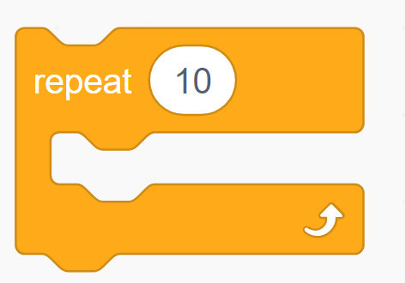
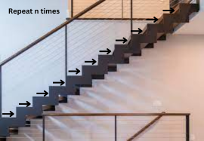
Repeat/For loops

Slide 11
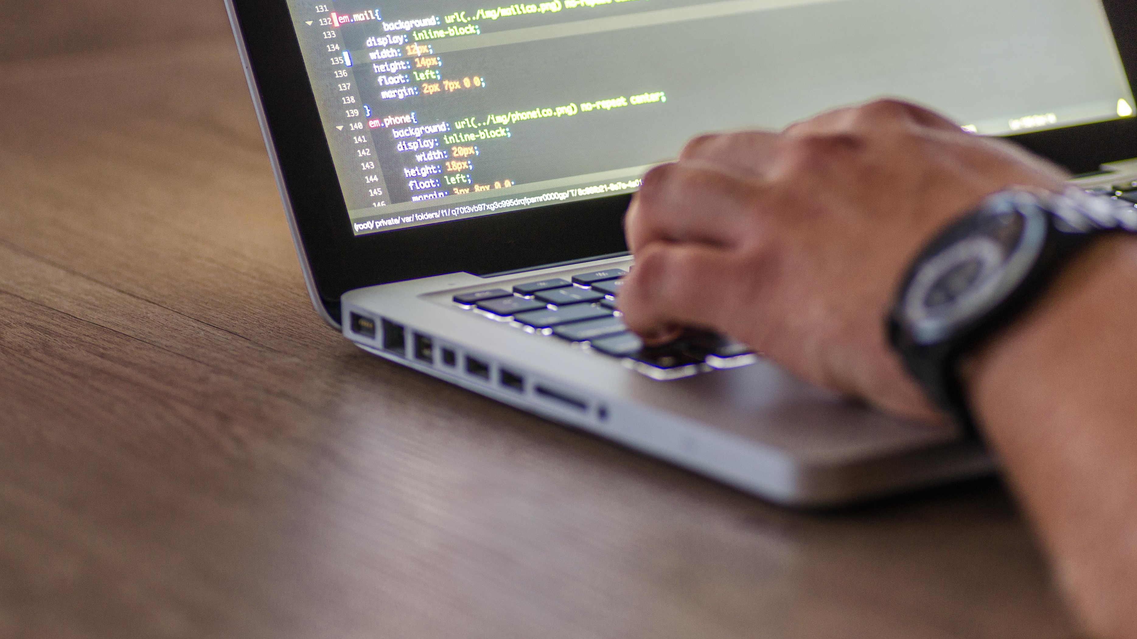
Your Turn to Try!

